Slide 1
Robot programming workshop
Jennifer Lärkäng

Slide 2
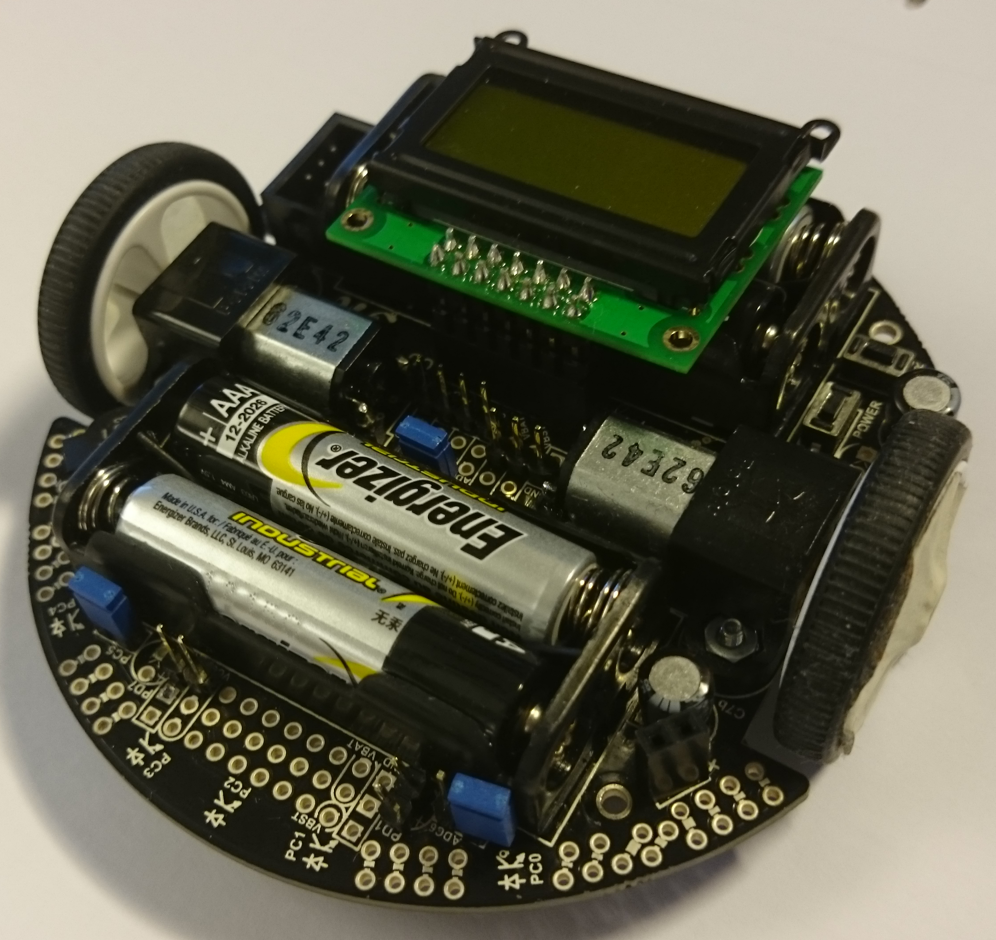

Polulu 3Pi Robot
2 wheels (individual motors, bidirectional)
2-line Display
3 Buttons
Buzzer
5 IR emitters and sensors (detecting surface reflection)
Extra equipment on some robots
Colour sensor and needle

Slide 3
Robot workshop
Basic exercises to get to know the robot and C programming
Track for staying inside an area
Track for line following
Follow the line
Go as fast as you can around the track
Find markers and pop baloons
Labyrinth
Anything else you might want to do with the robot! ☺

Slide 4
Robot workshop
10 groups, 4 persons in each
One robot per group
5 of the robots have the extra equipment
Virtual machine with the programming environment
Linux
Easy to use
For quick installation
Extensive Sample code to get started quickly

Slide 5
Interface
You will get this presentation as a file
No need to remember everything
Functions
Set motor speed
Write to the display
Make sounds with the buzzer
Get brightness sensor values (estimated angle to a black line on white surface)
Read colour sensor
All are used in the basic exercises (except reading the colour sensor)

Slide 6
Using the environment
Get it on a USB stick
Works on Windows and MAC
Install VMWarePlayer or VMWare Fusion
Copy the Virtual machine file and start it from VMWarePlayer
Demo…

Slide 7
Documentation
No heavy documents, much air and figures ☺
Guide to the development environment
API and exercises
Getting started with C
Hints
Full solutions

Slide 8
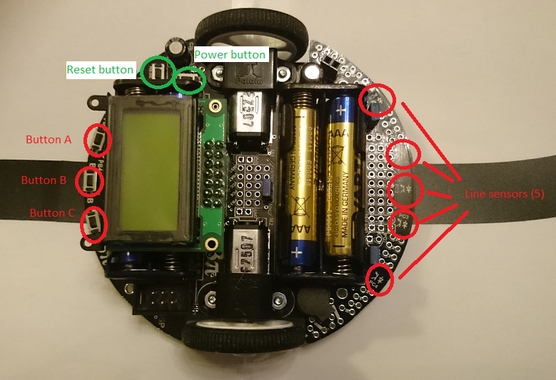
Getting to know the robot

Slide 9
Tips
If the robot suddenly stops seamingly without reason
new batteries might be needed
Downloading sometimes fails ☹ , in that case try again and again… or in the worst case, restart the virtual machine
When you are done with the basic exercises, you can ask me for further instructions
Have fun! ☺
We are here to help!

Slide 10
Questions?

